Slide 1
The neuro revolution
Better body and better brain
Dr Sara Pugh

Slide 2
What’s it got to go with me?
Do you have or know someone who has aches and pains that won’t go?
Do you feel like you could be more flexible or stronger?
Do you have or know anyone with balance issues?
Do you have issues with visual skills and coordination?
Do you feel that you could think more clearly?

Slide 3
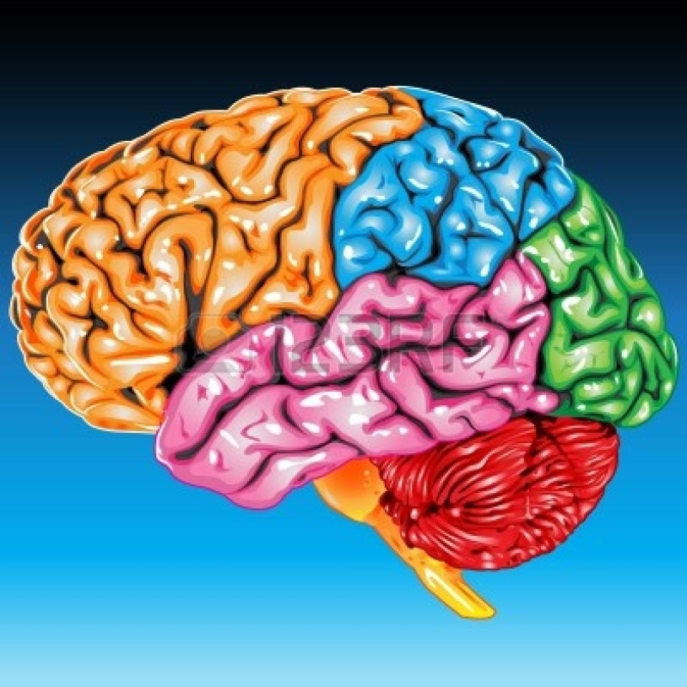
123 of brain function
The brain’s primary objective is survival
The brain needs
a) Fuel b) Activation
The brain receives an input, makes a decision and produces an output

Slide 4
Neurology 101
Input this comes from eyes, ears, skin, joints via receptors
Quality matters eg drunk people texting or emailing lots of input, but is it good quality?
Decision this is the brain attaching meaning to the input, comparing it to all other pasts experiences and making a decision
Output this is usually movement but also organ response, blood pressure changes

Slide 5
Pain
Pain is a 1st order action signal
Pain is produced by the brain, not the body
Meaning you are doing something your brain doesn't like
It wants you to change something and it will keep bugging you until you do
A stressed out brain makes more pain than a happy one

Slide 6
Movement
The brain decides how you use your joints, how much mobility you have and how strong you are.
If your brain and joints don't communicate well then you brain won’t let you move them as well as you could.
‘Sensory before motor’ you need to be able to feel it before you can move it properly

Slide 7
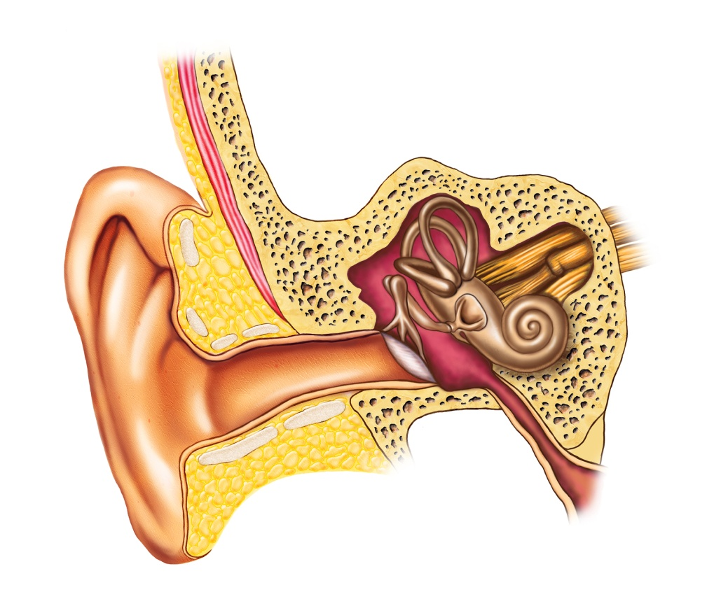
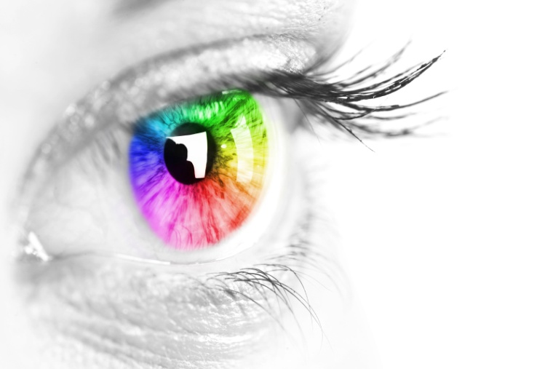
Balance and vision
Your brain needs to know
Where you are in space
Where your head is in relation to your body
Which way is up
If you balance system (inner ear/vestibular system) and eyes are giving bad input, brain doesn't know where you are. This is not safe

Slide 8
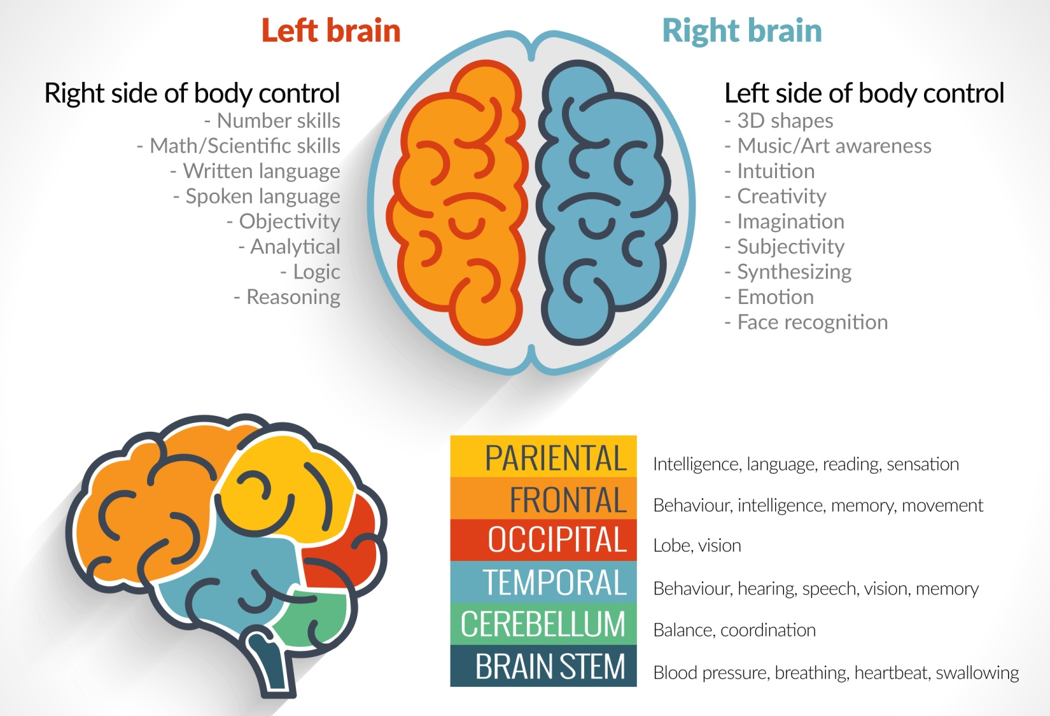

Slide 9
Want good brain function?
Make sure the brain is getting the best possible input so it can produce the best possible output
Make the 'boring' housekeeping functions, like standing up easy for your brain, so that there is energy left over for the 'interesting' stuff.
So to be healthy you need to see well, balance well, move well and breath well

Slide 10
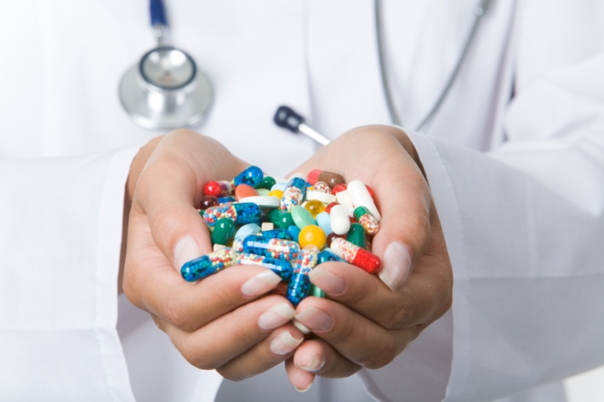
What do I do?
I work to help people have better brains and better bodies
The brain is the big boss, it is in charge of the nervous system
You can take drugs which effect the whole brain or do functional neurology and target specific parts.

Slide 12
What people say
“Working with Sara Pugh I have found relief from the Parkinson’s symptoms that I had been displaying for years. I noticed improvements in my mobility. Sara has some great ideas on improving the lives of Parkinson’s sufferers and I would recommend her work.”
Renee Dickinson Chair for Harrogate Parkinson's UK
"Sara did a brain training session with me, my business partner and our team at our workplace. The team loved it, they were buzzing, we are going to book another session."
Tony Cuthbertson Director IMP Media

Slide 13
Thank you for reading
Any questions ?
Contact
info@sarapughleeds.co.uk
07765662579
@Spugh01
https://www.facebook.com/sara.pugh.12

